Slide 1
Weight of Evidence(WOE)
Information Value(IV)

Slide 2
Contents
Handling Categorical Variables
Weight of Evidence (WoE)
Information Value
WoE and Information Value in Python

Slide 3
Handling Categorical Variables In Statistical Models
In classification or regression problems independent variables can either be continuous or categorical. Categorical variable can have limited number of categories or many categories as shown in the following table.
Generally, when independent variables in statistical models are categorical, they are replaced and represented by Dummy Variables.
If there are k categorical variables, then they are represented by k-1 Dummy Variables.
Type | Example
Variable with limited categories | Age Groups: Below 15 = 1, 15-25 = 2, Above 25 = 3
Variables with large number of categories | City or Country will have many levels

Slide 4

Weight of Evidence (WoE)
Weight of Evidence (WoE) estimates the predictive power of an independent variable in relation to the dependent variable.
WoE is originally used in credit risk analytics, as the method of separation of “good” and “bad” customers (Non-defaulters: Y=0 and Defaulters: Y=1)
WoE is defined as
Here, Distribution of Good is the proportion of good customers in a category to total good customers. Similarly, Distribution of Bad is the proportion of bad customers in a category to total bad customers.
Using WoE ,we can assign continuous value for each category. For instance, if there are 50 cities then there will be 50 WoE values.
$$\ln\left(\frac{Distribution of {Good}_{i}}{Distribution of {Bad}_{i}}\right)$$

Slide 5
Get an Edge!
Some thumb rules related to Weight of Evidence
Each category (bin) should have at least 5% of the observations.
Each category (bin) should be non-zero for both non-events and events.
The WoE should be distinct for each category. Similar groups should be aggregated.
The WoE should be monotonic, i.e. either growing or decreasing with the groupings (Not applicable when groups are for character strings).
Missing values are binned separately.

Slide 6
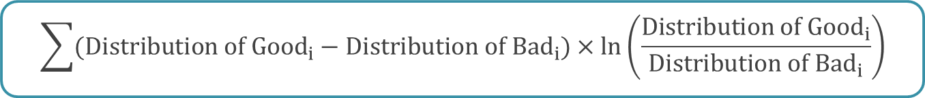
Information Value (IV)
Information Value (IV) is a highly useful tool for variable selection.
The concept has its roots in entropy in information theory.
IV of an independent variable expresses the amount of diagnostic information of that variable for separating the Goods from the Bads.
IV is calculated as
IV helps in ranking variables based on their importance.
$$\sum{(Distribution of {Good}_{i}−Distribution of {Bad}_{i})}×\ln\left(\frac{Distribution of {Good}_{i}}{Distribution of {Bad}_{i}}\right)$$
Weight of Evidence

Slide 7
Information Value (IV)
By convention, information values can be interpreted as follows:
Value | Predictive Power
< 0.02 | Not useful for prediction
0.02 to 0.1 | Weak predictor
0.1 to 0.3 | Medium predictor
0.3 to 0.5 | Strong predictor
> 0.5 | Suspicious predictive power

Slide 8
Case Study – Predicting Loan Defaulters
Background
Objective
Available Information
The bank possesses demographic and transactional data of its loan customers. If the bank has a robust model to predict defaulters it can undertake better resource allocation.
To predict whether the customer applying for the loan will be a defaulter.
Sample size is 700
Independent Variables: Age group, Town, Years at current address, Years at current employer, Debt to Income Ratio, Credit to Debit ratio, Other Debts
Dependent Variables: Defaulter (=1 if defaulter, 0 otherwise)

Slide 9
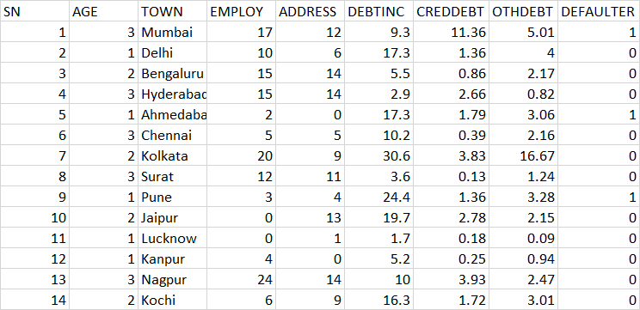
Data Snapshot
Independent Variables
Dependent Variable
Column | Description | Type | Measurement | Possible Values
SN | Serial Number | Numeric | - | -
AGE | Age Groups | Categorical | 1(<28 years), 2(28-40 years), 3(>40 years) | 3
TOWN | Customer Belonging to Which Town | Categorical | Mumbai, Delhi,etc.. | 15
EMPLOY | Number of years customer working at current employer | Continuous | - | Positive value
ADDRESS | Number of years customer staying at current address | Continuous | - | Positive value
DEBTINC | Debt to Income Ratio | Continuous | - | Positive value
CREDDEBT | Credit to Debit Ratio | Continuous | - | Positive value
OTHDEBT | Other Debt | Continuous | - | Positive value
DEFAULTER | Whether customer defaulted on loan | Binary | 1(Defaulter), 0(Non-Defaulter) | 2
Observations

Slide 10
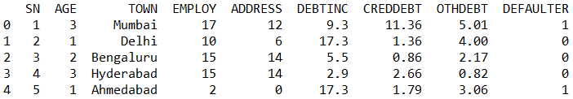
WoE and IV in Python
# Import the data
import pandas as pd import numpy as np data = pd.read_csv("BANK LOAN WOE-IV.csv") data.head() data.info()
# Output:
# Convert ‘AGE’ and ‘TOWN’ to Categorical
data['AGE'] = pd.Categorical(data['AGE']) data['TOWN'] = pd.Categorical(data['TOWN']) data.info()
pd.read_csv() is used to import csv file.
info() shows class and levels of variables in the data.
AGE and TOWN are actually categorical variables but represented as numeric and character respectively. We will convert it to Categorical using pd.Categorical() and then calculate WoE and IV for AGE and TOWN.

Slide 11
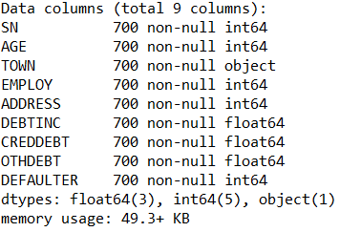
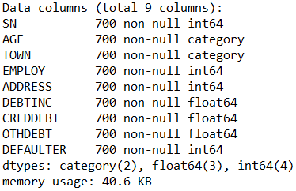
WoE and IV in Python
# Output:
Output of original data structure.
Output of modified data structure (converting ‘AGE’ & ‘TOWN’ into Categorical).
Interpretation:
Age initially as integer is converted to Categorical with 3 levels 1,2,3.

Slide 12
WoE and IV in Python
# Define function to calculate WoE and IV
unique() gives unique values
nunique() calculates distinct observations.
count() gives the non-NA cells for each column or row.
def calculate_woe_iv(dataset, feature, target): lst = [] for i in range(dataset[feature].nunique()): val = list(dataset[feature].unique())[i] lst.append({ 'Value': val, 'All': dataset[dataset[feature] == val].count()[feature], 'Good': dataset[(dataset[feature] == val) & (dataset[target] == 0)].count()[feature], 'Bad': dataset[(dataset[feature] == val) & (dataset[target] == 1)].count()[feature] }) dset = pd.DataFrame(lst) dset['Distr_Good'] = dset['Good'] / dset['Good'].sum() dset['Distr_Bad'] = dset['Bad'] / dset['Bad'].sum() dset['WoE'] = np.log(dset['Distr_Good'] / dset['Distr_Bad']) dset = dset.replace({'WoE': {np.inf: 0, -np.inf: 0}}) dset['IV'] = (dset['Distr_Good'] - dset['Distr_Bad']) * dset['WoE'] iv = dset['IV'].sum() dset = dset.sort_values(by='WoE') return dset, iv

Slide 13
WoE and IV in Python
# Convert numeric data into bins
data['DEBTINC_bin']= pd.qcut(data['DEBTINC'], 10) data['CREDDEBT_bin']= pd.qcut(data['CREDDEBT'], 10) data['ADDRESS_bin']= pd.qcut(data['ADDRESS'], 10) data['SN_bin']= pd.qcut(data['SN'], 10) data['OTHDEBT_bin']= pd.qcut(data['OTHDEBT'], 10) data['EMPLOY_bin']= pd.qcut(data['EMPLOY'], 10)
pd.qcut() is quantile-based discretization function. Discretize variable into equal-sized buckets based on rank or based on sample quantiles. Here bin size is kept 10.
# Subset data for WoE and IV calculation
data2 = data[['AGE','TOWN','DEBTINC_bin','CREDDEBT_bin','ADDRESS_bin', 'SN_bin','OTHDEBT_bin','EMPLOY_bin','DEFAULTER']]

Slide 14
WoE and IV in Python
# Calculate WoE and IV
lst = [] iv_list = [] for col in data2.columns: if col == 'DEFAULTER': continue df, iv = calculate_woe_iv(data2, col, 'DEFAULTER') lst.append(df) iv_list.append({"Variable": col, "IV": iv}) IV_df = pd.DataFrame(iv_list)
calculate_woe_iv generates WoE and IV for all variables in the data except dependent variable which is specified as “column_name” in separate ‘df’ stored in list ‘lst’.
# Get WoE and IV values for ‘AGE’ variable
data_AGE = lst[0]
Extract dataframe for ‘AGE’ from ‘lst’

Slide 15

WoE and IV in Python
data_AGE
# Output :
Interpretation:
Output table contains categories of the variable, count of Good, Bad and their respective distributions for each category, WoE and IV values.

Slide 16
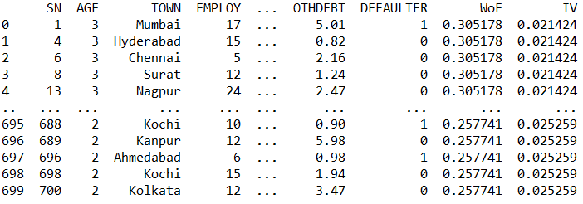
Appending WoE Values to Original Data
# Check the type of key variable before merging
data_AGE = data_AGE.rename(columns={"Value": "AGE"}) result = pd.merge(data, data_AGE[['AGE','WoE','IV']], on='AGE') result
Make ‘AGE’ as the common variable in the original data and WoE data.
Type of ‘AGE’ in both data should be common for merging datasets.
# Output :

Slide 17
Binary Logistic Model
# Binary Logistic Model with AGE as FACTOR
import statsmodels.formula.api as smf import statsmodels.api as sm riskmodel=smf.glm('DEFAULTER ~ AGE + EMPLOY + ADDRESS + DEBTINC + CREDDEBT + OTHDEBT',data=data, family = sm.families.Binomial(sm.families.links.logit())).fit()
# Binary Logistic Model using ‘WOE’ as a predictor instead of ‘AGE’
riskmodel2=smf.glm('DEFAULTER ~ WoE + EMPLOY + ADDRESS + DEBTINC + CREDDEBT + OTHDEBT',data=result, family = sm.families.Binomial(sm.families.links.logit())).fit()

Slide 18
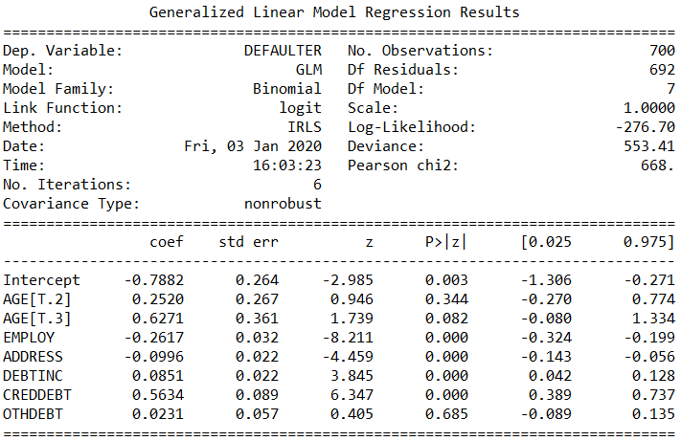
Binary Logistic Model
riskmodel.summary()
# Output :
Interpretation:
Model with Age as Category creates 2 dummy variables.
P values for both dummy variables are greater than 0.05. Therefore, the impact of AGE is statistically insignificant.

Slide 19
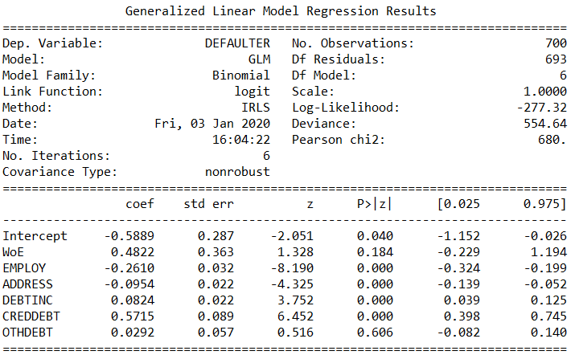
Binary Logistic Model
riskmodel2.summary()
# Output :
Interpretation:
Model with WOE as a predictor gives one P value
The P value for WOE is greater than 0.05. Therefore, the impact of AGE is statistically insignificant.

Slide 20
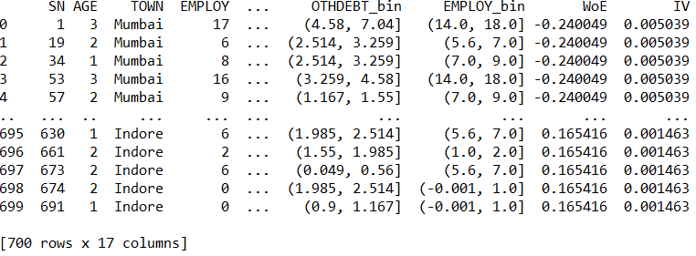
WoE of Character Variable
# WoE and IV for variable ‘TOWN’
data_TOWN = lst[1] data_TOWN = data_TOWN.rename(columns={"Value": "TOWN"}) result2 = pd.merge(data, data_TOWN[['TOWN','WoE','IV']], on='TOWN') result2
# Output :

Slide 21
Information Value (IV) Interpretation
# Extracting IV for all predictor variables
IV_df
IV_df is the dataframe used to store results of IV from calculate_woe_iv function.
calculate_woe_iv returns dataframe with WoE and IV values for individual variable and total IV value of each variable.

Slide 22
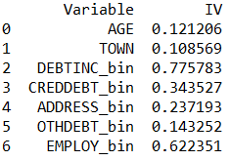
Information Value Interpretation
# Output :
Interpretation:
With the help of table ‘IV values and its Predictive Power’ on slide number 7 we can say that,
- Town and Age are weak predictor.
- Othdebt, Creddebt, Address have medium predictive power.
- Employ and Debtinc are strong predictor.

Slide 23
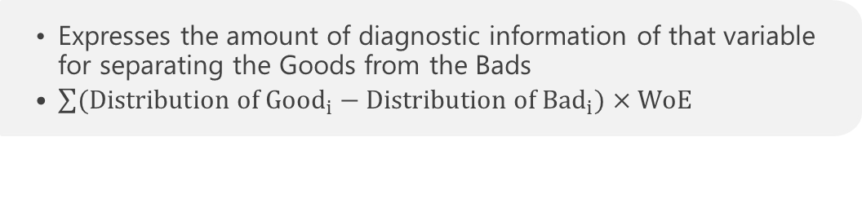
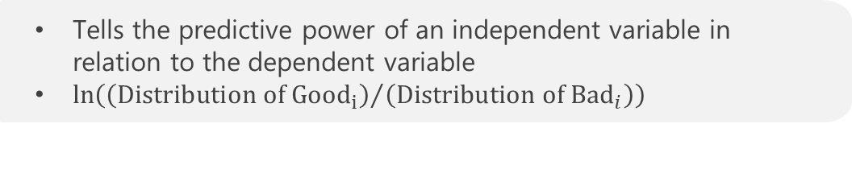
Quick Recap
In this session, we learnt how to compute and use Weight of Evidence and Information Value:
Weight of Evidence
Tells the predictive power of an independent variable in relation to the dependent variable
$\ln\left({\left(Distribution of {Good}_{i}\right)}/{\left(Distribution of {Bad}_{i}\right)}\right)$
Information Value
  Expresses the amount of diagnostic information of that variable for separating the Goods from the Bads
  $\sum{(Distribution of {Good}_{i}−Distribution of {Bad}_{i})}×WoE$
Weight of Evidence and Information Value in Python
  In Python there is no direct function for calculation of WoE and IV.
  We create user defined function for WoE, IV calculation.
  For obtaining IV of each variable continuous numeric data is converted into bins using pd.qcut().

Slide 24
THANK YOU!

